Slide 1



PART : Pre-trained Authorship Representation Transformer
Capstone Project Phase 2
Presenting:
Tuval Zitelbach 316219633 Meitar El-Ezra 318608742
Notes:
Hi, this is Meitar, I am Tuval
And we are going to present to you a model named PART : a pre trained authorship representation transformer.

Slide 2
What are we going to discuss:
Problem definition
PART model’s architecture
Experimentation
Results
UML diagrams and tests table
GUI presentation video
Project conclusions
Notes:
First, we are going to define the problem the model aims to solve.
After that, we will present the architecture of the model.
Then we will discuss the Graphic User Interface that will be use for testing the model:
We will display a UML use-case diagram for the interface, the interface itself, and the functionality tests table.

Slide 3
Problem Definition
Notes:
So, let’s define the problem.

Slide 4
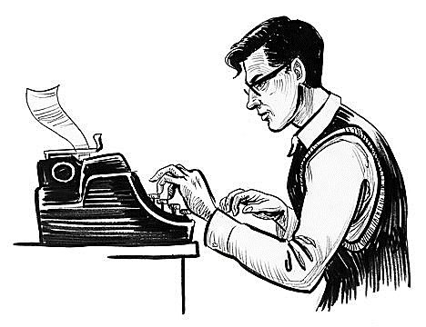

Documents written by the author
Author
D1
PART model
D2
. . .
Dn
ek | … | e3 | e2 | e1
ek | … | e3 | e2 | e1
… | … | e3 | e2 | e1
ek | … | e3 | e2 | e1
E1
Similarity (E1, En) = MAX
E2
En
Authorship embeddings
Notes:
This is a general flow of the process.
There is an author.
he wrote some documents.
The documents can be inserted to the PART model.
The model will produce matching embedding vectors for each document.
Those vectors are named Authorship Embeddings.
When checking the similarity of 2 of the embeddings, we will get a MAX value.

Slide 5
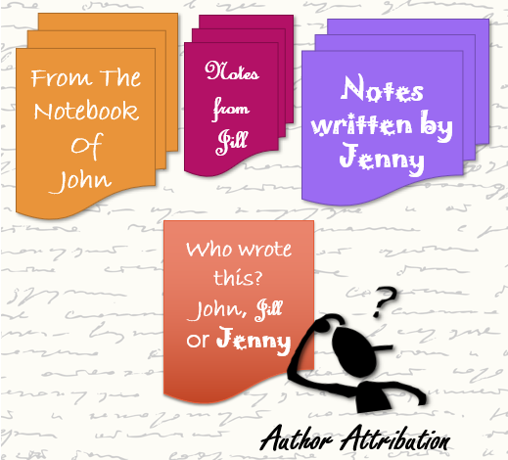
Authorship Attribution
The goal of authorship attribution is to identify the most likely author of an anonymous document among a set of known candidate authors.
Notes:
This model deals with authorship attribution.
The goal with the task of authorship attribution is to identify an author of a document.
Like it the picture. You can see there are 3 sets of texts, written by John, Jill and Jenny.
We want to find out who wrote the red note according to previous information we learnt about the different authors.

Slide 6

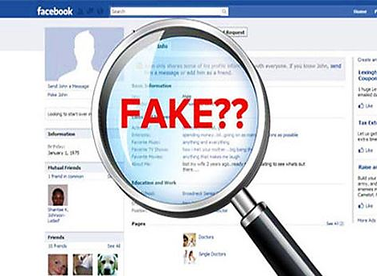
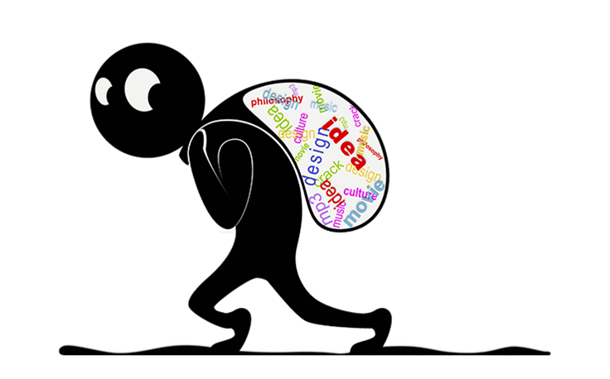
Analyzing those attributions can contribute to several fields, such as forensics, plagiarism detection, social networks analysis, identifying fake news or profiles and more.
Notes:
Among the fields that would profit from the ability to attribute authorship we have:
Forensics and linguistics for example,
Social network analysis, identifying fake news and profiles,
Plagiarism detection and more.

Slide 7
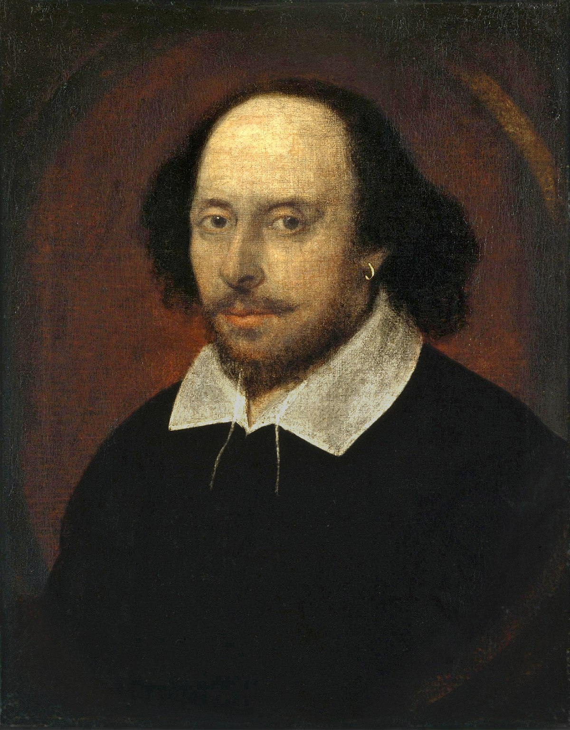


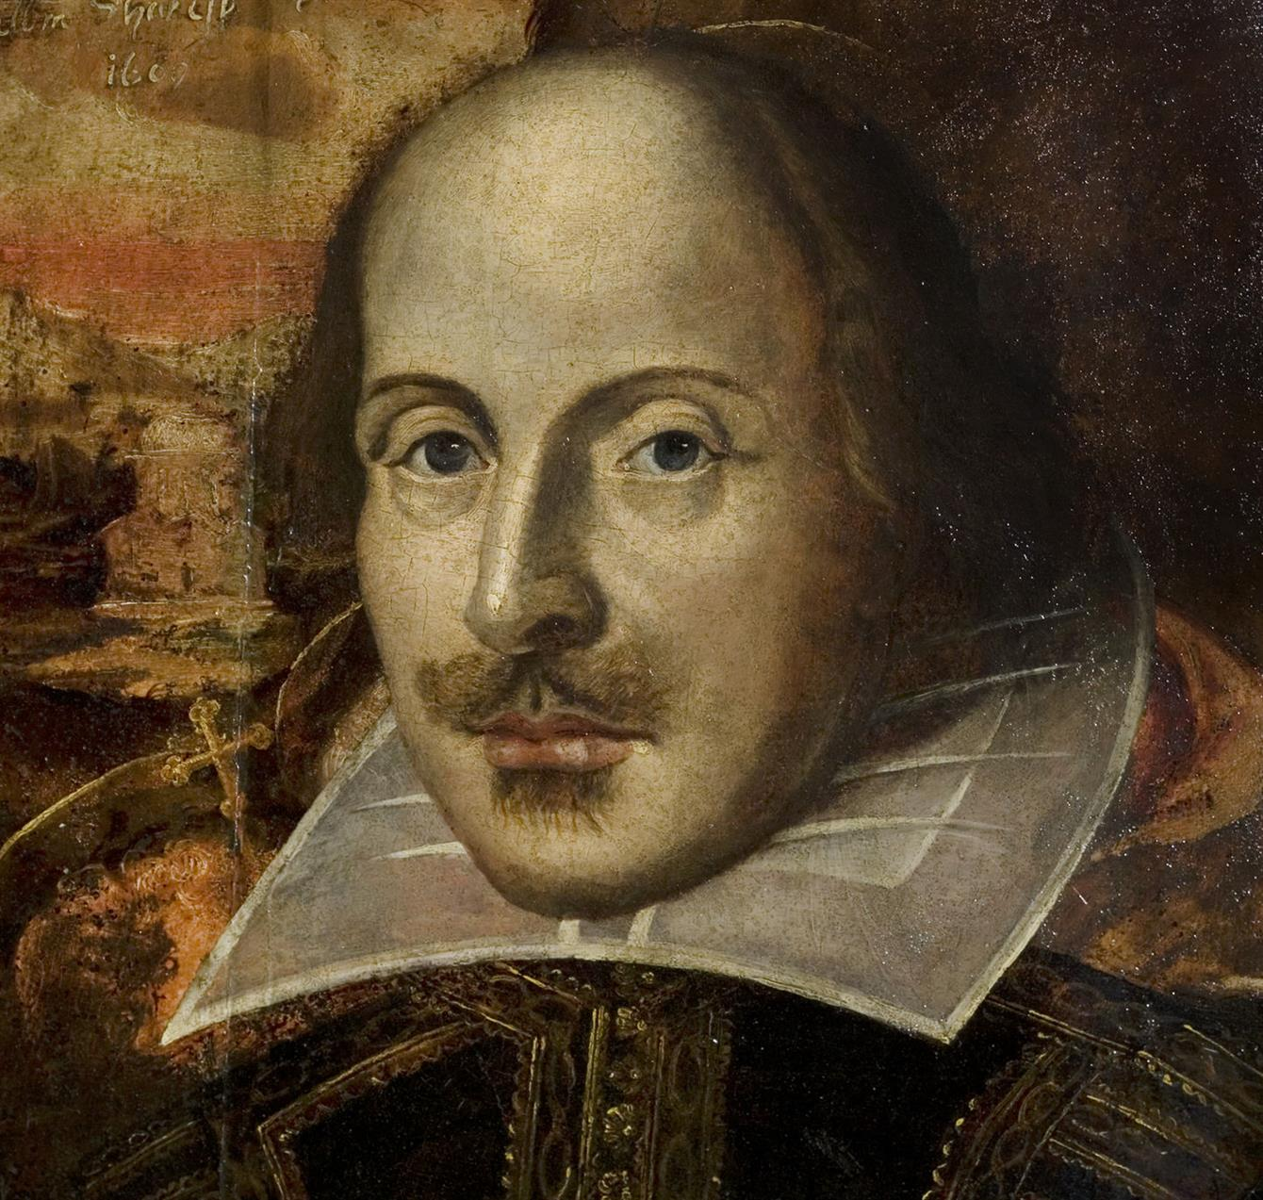

Project’s goal: Plagiarism Detection
Specifically for texts written by Shakespeare.
PART model
E
ek | … | e3 | e2 | e1
PART model
Notes:
In this project, our goal is to be able to detect plagiarism done with works written by William Shakespeare .
Plagiarism is when a text written by a certain author, is “stolen” and signed by someone else.
What is going to happen is that the model, will recognize the writing style of Shakespeare (for example)
so when fed with a text Shakespeare wrote but signed by someone else or anonymously,
it would potentially produce the same embedding and uncover the theft.

Slide 8

An authorship embedding is a representation of a document’s author’s style as a numerical vector. Each document representation will be aligned towards the document’s author and not its contents.
Authorship embeddings are generated by a semi-supervised contrastive learning approach.
E
ek | … | e3 | e2 | e1
Notes:
So we said the model outputs “AUTHORSHIP EMBEDDINGS”. what are those authorship embeddings ?
An authorship embedding is a representation of the writing style of the author of a document.
In the form of a numerical vector.
The authorship embeddings are generated by a semi supervised contrastive learning approach.
The embeddings are vectors that project a document onto an authorship-aware hyper space.
A point in that space is an embedding and a representation of the document’s author’s style.
So, the embeddings are aligned to the author and not to the content of the given documents.
This graph for example, is taken from the original paper that introduced the authorship embeddings.
We are expecting that, like in the graph, embeddings of texts from the same author will be close to each other.

Slide 9


Each embedding Ei represents textual documents embedded in a numerical space. Ideally, the embedding will encode the features from the author by generating the same representation for different texts.
Author: i
Di
Ei
ek | … | e3 | e2 | e1
D’i
Notes:
If the system works perfectly, we can take 2 different documents of the same author, and the model will produce the same authorship embedding for them.

Slide 10
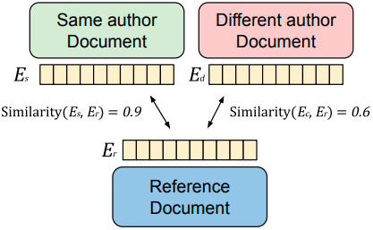
Authorship Embedding contrastive learning
Example of a comparison of authorship embeddings.
When compared with a similarity function, the related document similarity should be higher than an unrelated text.
Notes:
The vectors are generated by a contrastive learning approach.
This means that during training, the model is comparing pairs of positive and negative embeddings.
It uses the blue document's embedding as a reference for the comparing.
If we start with a positive sample, we compare the reference document with a document that has been written by the same author. Then the similarity function in the model would output a high value .
For a negative sample, we take a document from a different author. Then the similarity function would output a lower value.

Slide 11
A W. Shakespeare piece
Plagiarism suspect
Authorship Embedding contrastive learning
It is helpful for our project because, if plagiarism is performed, the model would be able to help detect it, as displayed:
A W. Shakespeare piece
Notes:
So for example, if we take a piece written by William Shakespeare as a reference and another document Shakespeare wrote we will get a high score.
The same thing will happen if we take a text somebody stole from Shakespeare, it would get a high score as well !
We can choose an appropriate threshold, and this way, plagiarism can be detected.

Slide 12
Architecture
Notes:
We now move on to the architecture that produces the authorship embeddings

Slide 13
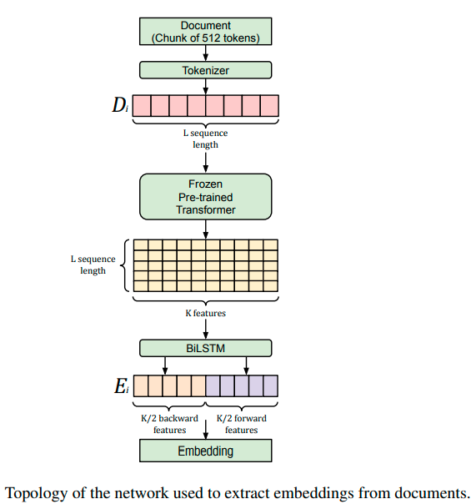
Pre-processing of the data
Semantic Word embeddings production
Authorship embeddings production
Notes:
The architecture is based on 3 important phases:
Preprocessing of the data
Word embedding production
And
Authorship embedding production which is the final output.
We will now delve into each part.

Slide 14
Pre-processing of the data
Notes:
Document preprocessing may include steps like tokenization, lowercasing and spelling correction.
So, for our task, for the first phase in the architecture : the data is divided into chunks, which are later tokenized. Afterwards we have L tokens.

Slide 15
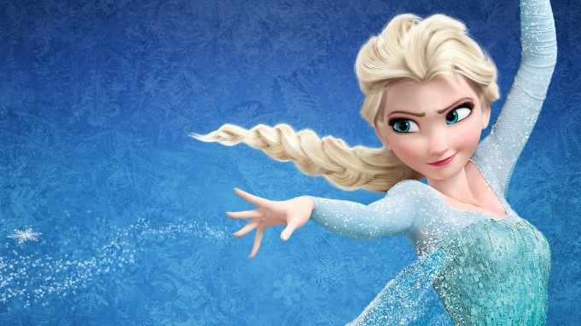
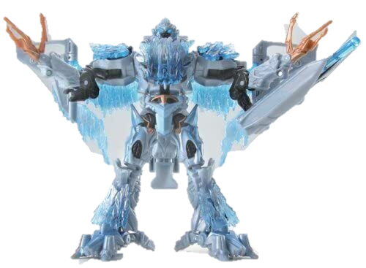
Frozen transformer
The main goal of the frozen transformer is to extract features for training the model, with speed, from the L tokens it is given.
Therefore, while training the model, the layers of the pre-trained transformer are being frozen, meaning the weights of the transformer are kept unmodified.
Notes:
Continuing to the second phase of the architecture :
The tokenized chunks of data are fed into a frozen transformer.
When a transformer is frozen it means the weights of layers in the pre-trained transformer are not changing.
It can work faster that way, and in this project, it helps with extracting features from the tokens.

Slide 16
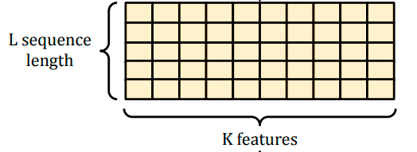

A semantic word embedding is a semantic word representation as a K dimensional vector, preserving the linguistical properties of the word.
Frozen transformer
For each of the L tokens
Notes:
The frozen transformer produces semantic word embeddings.
These are vector representations of the linguistic properties of the tokens.
So we take each of the L tokens simultaneously, feed it to the transformer and generate a K sized semantic word embedding, until we have a matrix of dimension LxK

Slide 17




Transfer Learning for Feature Extraction
A method where a model developed for a task is reused for a model on another task.
In this project’s case we extract features from the frozen transformer that learned to interpret language, and use them to produce the authorship embeddings.
Notes:
The use of a pre-trained frozen transformer illustrates the transfer learning method.
Transfer learning means that we train a model for a certain task and use it for a different task. In this case, we take the semantic word embeddings the transformer produces and shift them to capture the style of the author, to create an authorship attribution.

Slide 18

BiLSTM
A BiLSTM network is a common tool to catch text meaning. Each K sized word embedding is past through the forward and backward LSTM passes of the BiLSTM.
The output is the authorship embedding.
Notes:
Now we have reached the third and last phase of the PART architecture:
We pass the semantic word embeddings through a BiLSTM network.
BiLSTM network is commonly used for obtaining text meaning.
The word embedding passes through the BiLSTM – through the forward pass and through the backward pass
And the result of that process is a K sized vector, which is our final AUTHORSHIP EMBEDDING.

Slide 19
The model would train on datasets containing works of
William Shakespeare, other known authors
and
texts of Shakespeare’s imposters.
Training datasets
Imposters dataset | Gutenberg corpus | Documents written by Shakespeare
Notes:
The model will train on datasets that include works of different authors.
For our purposes, it will have documents written by W. Shakespeare and by other authors as well as texts of “imposters” which are suspected to have been written by Shakespeare but signed by other names.

Slide 20

Experimentation
This process was repeated least 3 times: 1. The documents from the datasets would be chosen randomly and divided in the ratio of 90% : 10% for training and testing, respectively.
2. train the model with the training set.
3. predict authorship embeddings on the testing set.
4. save the testing results.
The test results are then compared for analysis.
Notes:
The documents are chosen randomly and divided to training and testing sets, in a ratio of: 90 precents for training and 10 for testing.
The model is trained on the training set and predicts authorship embeddings for the testing set.
This process was done 3 times, each time choosing random documents of the dataset for testing and training.
After all that, the results of the testing rounds are compared and analyzed.

Slide 21

Comparisons to the original model
We, too, used RoBERTa large.
We began by downloading the datasets:
The Gutenberg dataset : we had to clone the GitHub repository of the "Standardized Project Gutenberg Corpus". Its size: over 70,000 books.
We took only the books that are written in English.
We picked the first 500 books because our means were not able to process this large amount of data.
For the task of plagiarism detection, two datasets of books: The Shakespeare novels (50 texts) and the imposters dataset (around 120 texts).
Notes:
In this project we used RoBERTa large as the transformer model in the architecture. We have consulted with the original writers and found this model produces better representations than other BERT encoder transformer models.
We used the Gutenberg corpus of texts. The original size of the dataset is 70,000 texts, we filtered them to be only in English, and took only 500 of the filtered texts.
We used 2 more datasets, which weren’t used in the original paper:
A dataset of texts signed by Shakespeare, which has around 50 texts.
And
A dataset of texts signed by other people which are suspected to have been written by Shakespeare- imposters, which has around 120 texts.

Slide 22
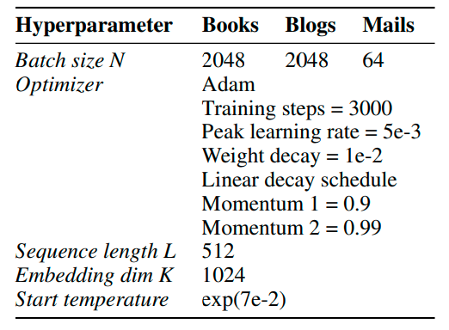
Training hyperparameters from the original PART paper
Training hyperparameters for our experiments
Shakespeare
imposters
128
128
128
Notes:
We also lowered significantly the batch size from 2048 to 128

Slide 23
Means for running the project
We use Google Colab Pro for the running of the training and testing of the model for its access to a GPU. The code for the project is in Python.
Libraries used for the implementation of the model :
Transformers
Pandas
Numpy
Wandb – gives an overview of the logs of the system while it’s running the model.
Notes:
The project was run on Google Colab Pro. It provided compute units, GPUs, memory size.
The code is in Python.

Slide 24
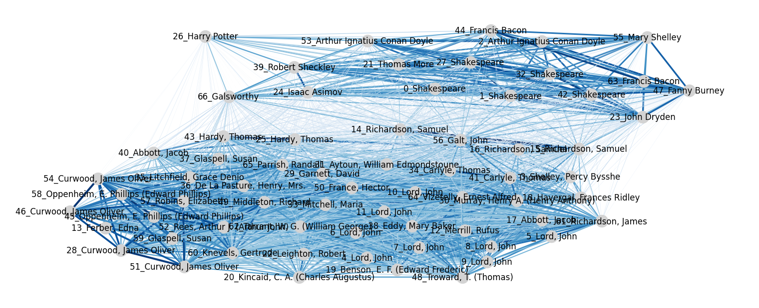
Results: 1st test round
This graph represents the cosine similarity between each embedding
Notes:
We will now present the results of the 3 testing rounds we made.
This is the first test result.
In this diagram, each node is the embedding for the author’s style of a text in the testing set. This diagram represents the cosine similarity between the different embedding. Closer embedding in similarity will be close to one another, and the edges between them will be shorter, and vice versa.

Slide 25
Books by Shakespeare
Notes:
In this first result, we can see the 5 texts written and signed by Shakespeare very close to one another.

Slide 26
Books by Shakespeare
Books by the imposters
Notes:
Around them we see another 10 to 12 embeddings. These nodes represent texts from the imposters’ dataset. These embedding are close to the ones by Shakespeare which would indicate a similar writing style and attributes for the writer of those texts, to Shakespeare.

Slide 27
Books by Shakespeare
Books from Gutenberg
Notes:
On the other hand, in this cluster, we see the texts from the Gutenberg corpus. They are further than the Shakespearean stylistic texts and their imposters.

Slide 28
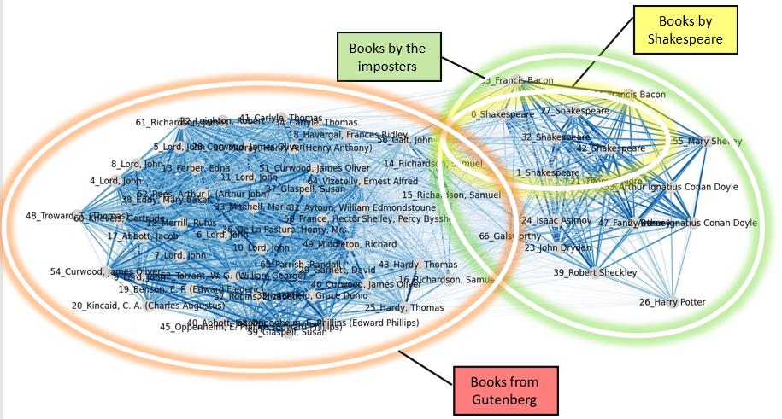
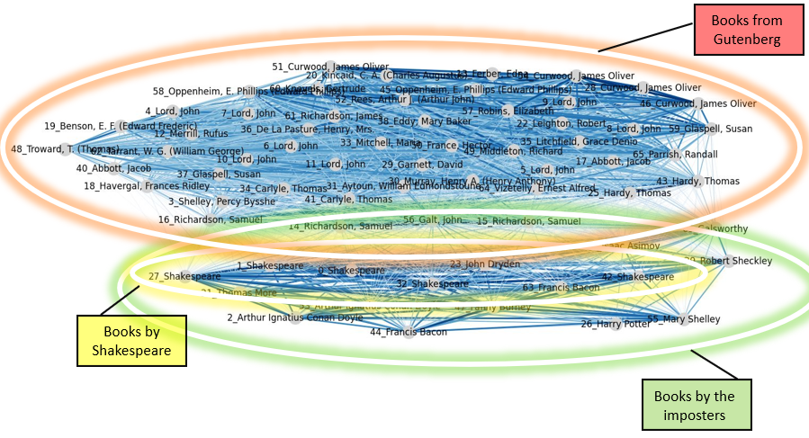
Results: 2nd test round
Results: 3rd test round
Notes:
Here we see the results of the second and third rounds.
The situation are very similar. We can see 2 clusters. One with the Shakespearean texts in its kernel, surrounded by the imposters’ embeddings, the other with all the other texts by random authors.

Slide 29

The results are consistent and as expected, Shakespeare and the suspected imposters are translated by the model to embeddings which are close, while other texts by other authors are found in different areas.
Notes:
The results are consistent and as expected, Shakespeare and the suspected imposters are translated by the model to embeddings which are close, while other texts by other authors are found in different areas.

Slide 30
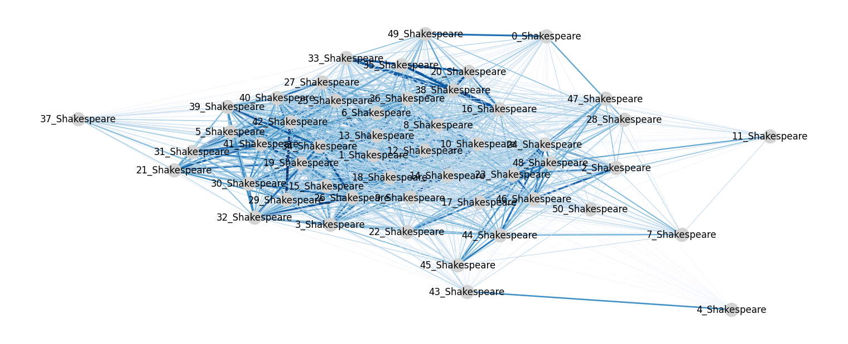
Here we tested the model on the entirety of the Shakespearean texts' dataset.
Notes:
Another test we made was like so:
we tested the model on the entirety of the Shakespearean texts' dataset.

Slide 31
These texts may not have actually been written by Shakespeare, although they were attributed to him:
Notes:
We can see there is a kernel of texts, meaning they are all close to each other in the author’s writing style.
There are 3 texts which are significantly distanced from the group. Those texts are attributed to Shakespeare, however, there is a chance they were wrongly attributed, and have been written by somebody else.

Slide 32
UML diagram
Notes:
Now we will present a UseCase diagram describing the system of the GUI that will be developed in part B of the project.

Slide 33
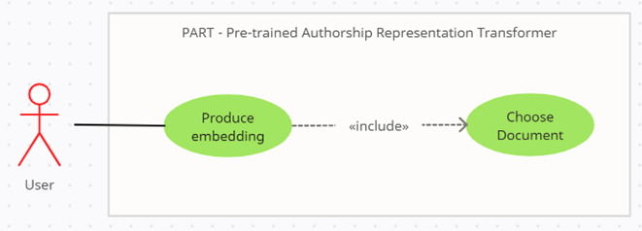
GUI Use-Case diagram
Notes:
This is the UC diagram.
A user in the system is anyone who wants to test it or produce an authorship embedding for a text.
The user can produce an embedding for a document to his choosing, after the model is trained.

Slide 34
GUI
Notes:
We’ll continue to the GUI presentation

Slide 35
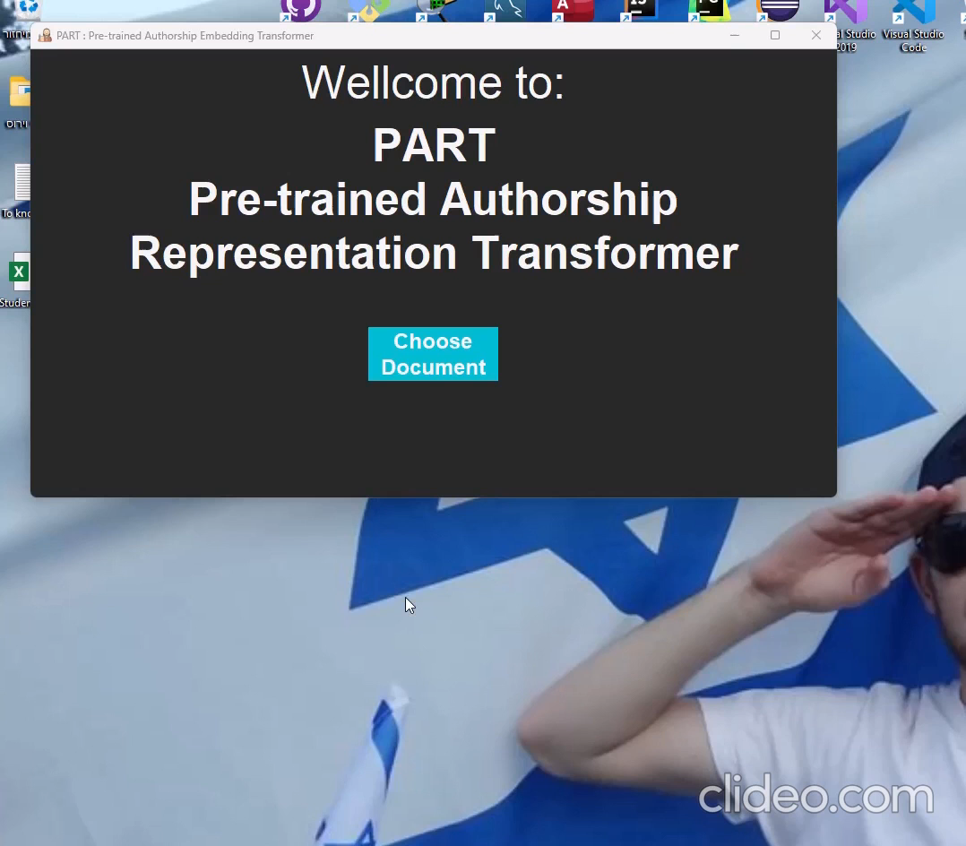

Slide 36


Test Number | Test Subject | Expected Result
1 | Press “Choose Document” | The window “Choosing Document” appears with “Create Embedding” button.
2 | Press "Create Embedding" | “No Selection” error window opens.
3 | Press "Ok" | “No Selection” error window closes.
4 | Select a document from the dropdown lists | Document is selected
5 | Press "Create Embedding" | “Loading Embedding Document” window appears. When finishes, loads window “Document’s authorship embedding display”
Tests table
Notes:
This are the functionality tests the GUI system will need to pass, each one with it’s expected result.

Slide 37
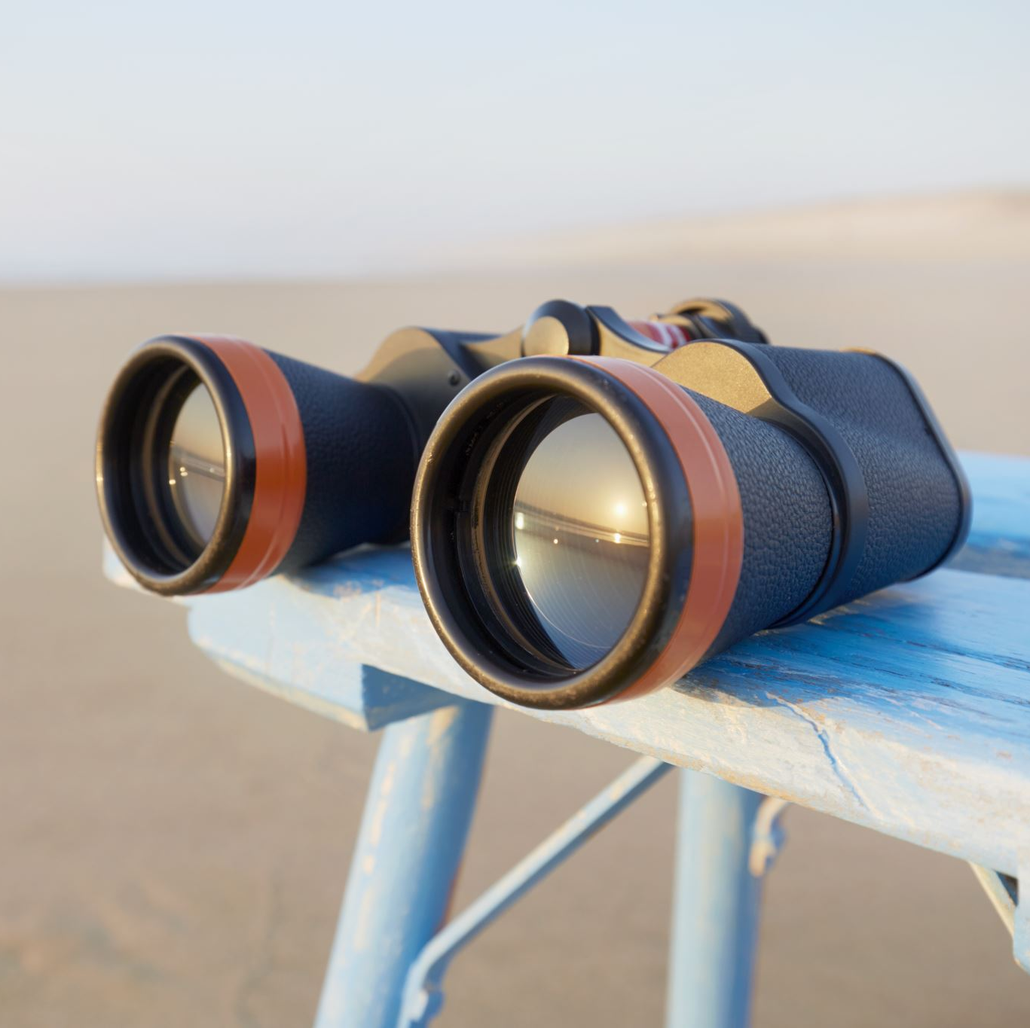
Did the project match our expectations?
The goals of the project were achieved partly.
We were able to implement the discussed architecture. The training itself had to be under limitations due to shortcomings in the resources we had.
We achieved results, but the results could be better, given better environmental conditions, including better hardware, more time etc.
Notes:
The goals of the project were achieved partly.
We were able to implement the discussed architecture.
The training itself had to be under limitations due to shortcomings in the resources we had.
We achieved results, but the results could be better, given better environmental conditions, including better hardware, more time etc.
Using the original paper’s hyperparameters or other more sophisticated transformer models could also affect the results of the experiments for the better .

Slide 38

Future research
We see future development of this network in our field of coding.
It could be trained and used for plagiarism detection in new algorithms and startup software codes.

Slide 39
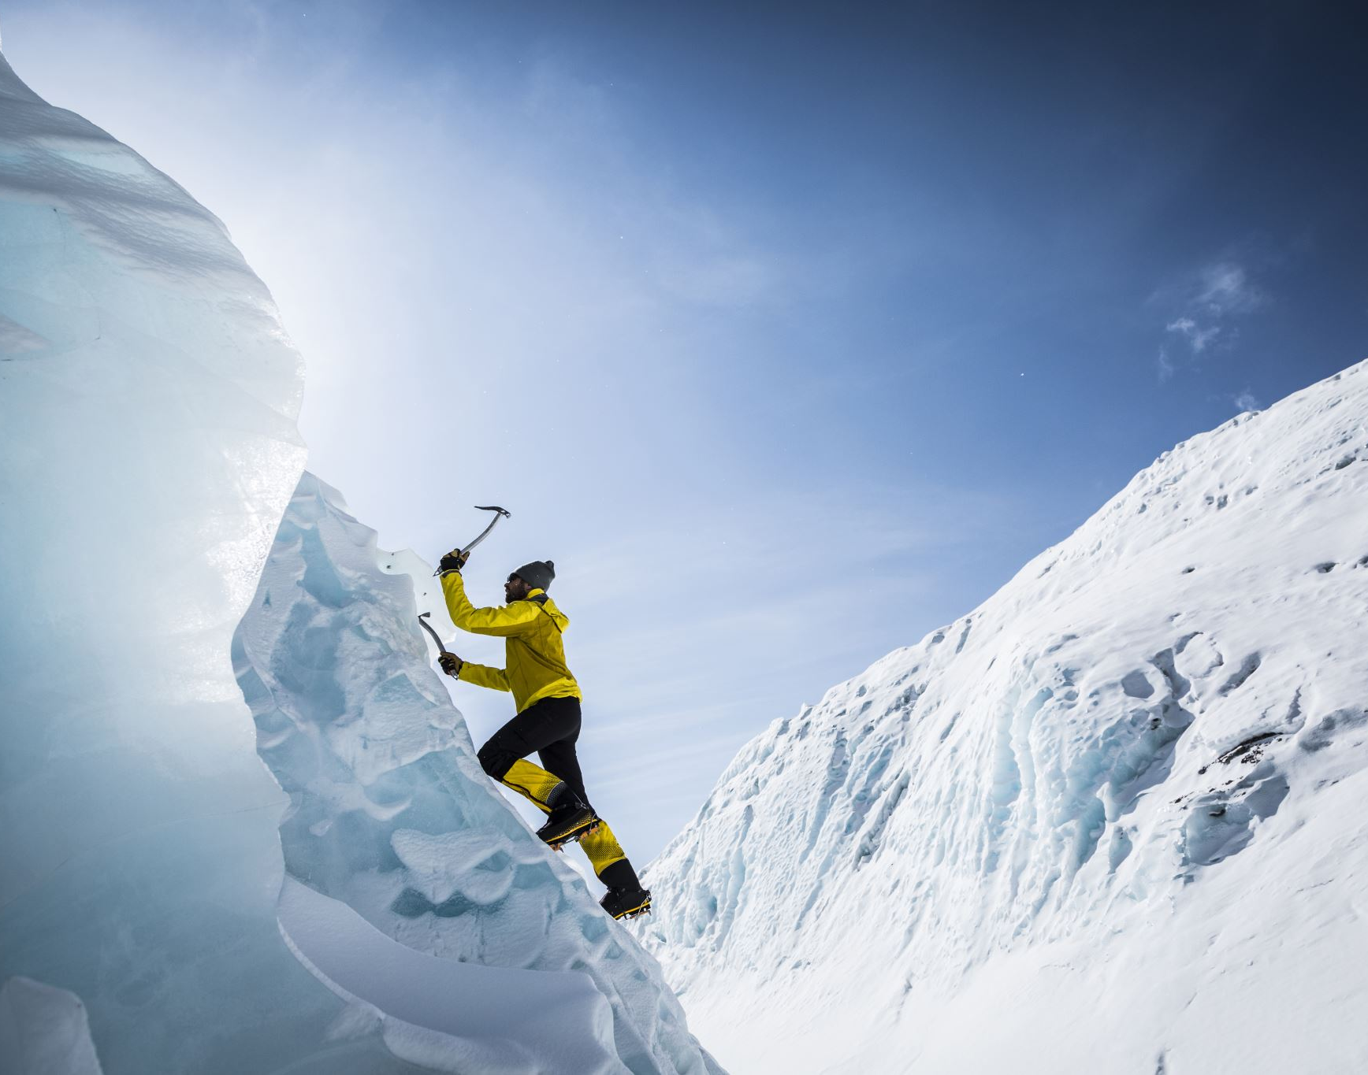
Challenges and constraints faced :
Gathering the data for the training and testing of the model:
The downloading of it proved more difficult than expected.
High downloading time, mainly due to the size which we had to downsize it significantly.
Originally, blogs dataset was supposed to be used as well, but was omitted since it was too heavy; 780 MB.
Training and testing processes were too long and cost too many of the resources Google Collab Pro provided.
Notes:
Gathering the data for the training and testing of the model:
The downloading of it proved more difficult than expected.
High downloading time, mainly due to the size which we had to downsize it significantly.
Originally, blogs dataset was supposed to be used as well, but was omitted since it was too heavy; 780 MB.
Training and testing processes were too long and cost too many of the resources Google Collab Pro provided.
Also, developing GUI in Google Colab is not ideal so we needed to find a way to manipulate the data of the processes from the model to be used in a regular IDE for the GUI.

Slide 40

Thank you for listening!
Meitar El-Ezra Tuval Zitelbach
Notes:
Thank you for listening !
Tuval and Meitar

